Slide 1
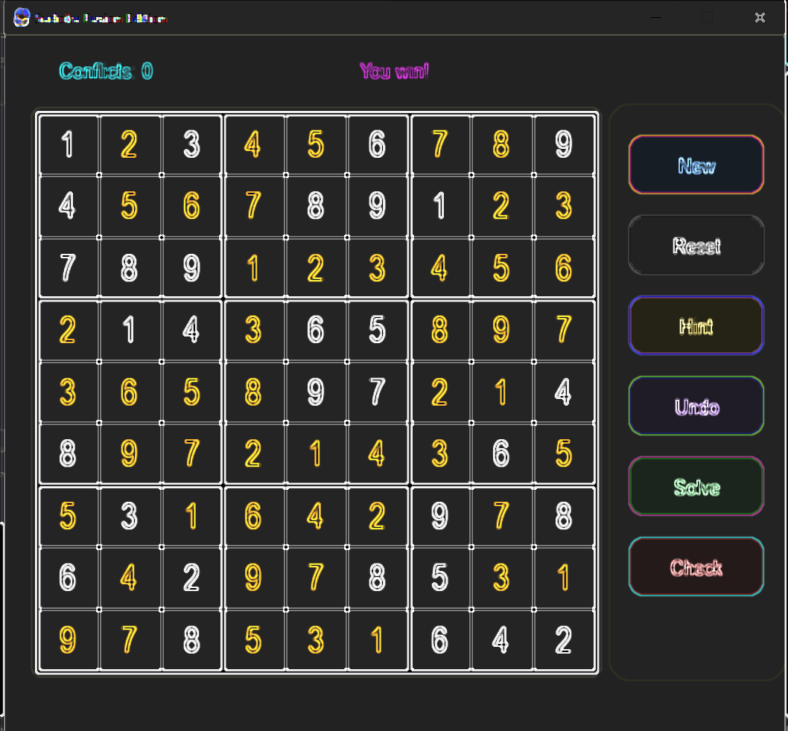
WELCOME TO SUDOKU_SOLVER
GROUP MEMBERS:
SONIYA INAYAT 1378
NOSHEEN ZEHRA 1404
RABIA BATOOL 1390
ALINA KULSOOM 1366

Slide 2
Introduction
Sudoku is a logic-based, combinatorial number-placement puzzle.
Objective: Fill a 9×9 grid so each column, row, and 3×3 section contains digits 1 to 9.
Our project recreates Sudoku in Python using Pygame with modern features.
2
1
SUDOKU
GAME
SOLVER
2
3

Slide 3
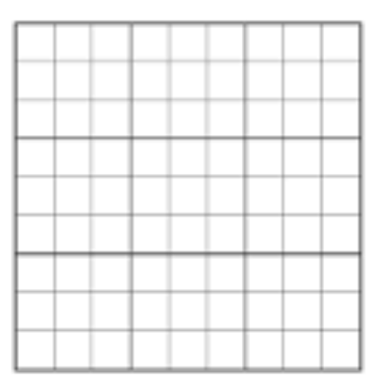
SUDOKU_WINDOW_
BOARD

Slide 4
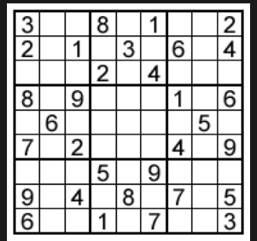

Slide 5

Project Objective
1
5
To design an interactive Sudoku game using Python and Pygame.
To provide a fun and logical problem-solving environment.
To add modern usability features such as hints, undo, and validation.
Implement a Smart Sudoku Solver — Uses backtracking to fill the grid logically.
2
3
4

Slide 6
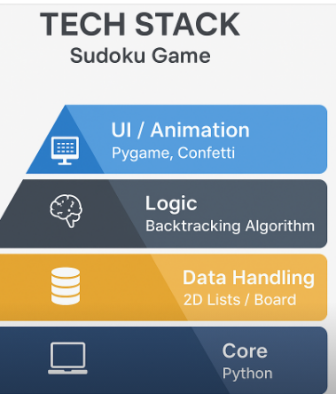
Tech Stack
Programming Language: Python
Graphics Library: Pygame (for UI, visuals, sounds, and event handling)
Algorithm: Backtracking (used to solve Sudoku puzzles efficiently)
Sound Management: Pygame Mixer (for clicks, errors, and victory effects)
Data Structures: 2D Lists (to represent Sudoku grids)
Development Tools: VS Code / PyCharm
1
2
3
4
5
6

Slide 7
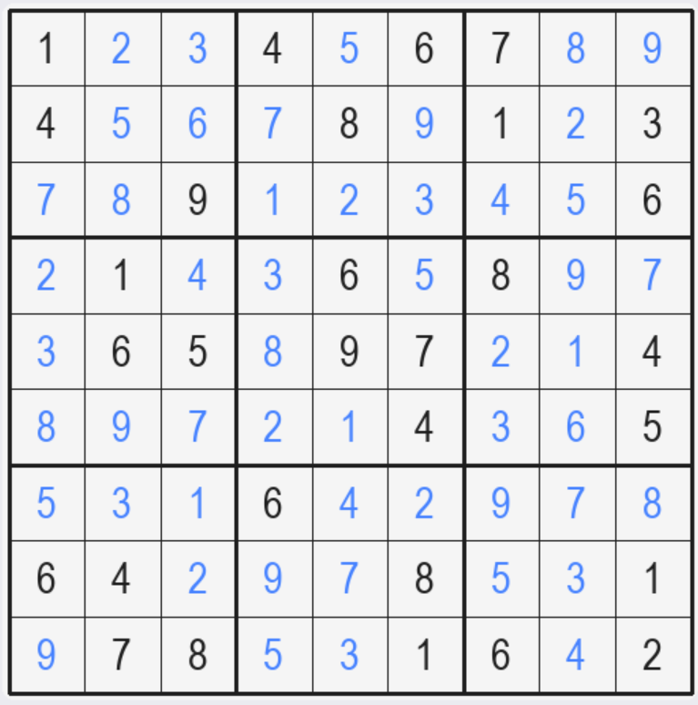
Game Logic
1
2
3
The Sudoku grid is represented as a 2D array (9×9).
Each cell can be locked (default number) or editable (user input)
Validation checks ensure each number follows Sudoku rules (no repetition).

Slide 8
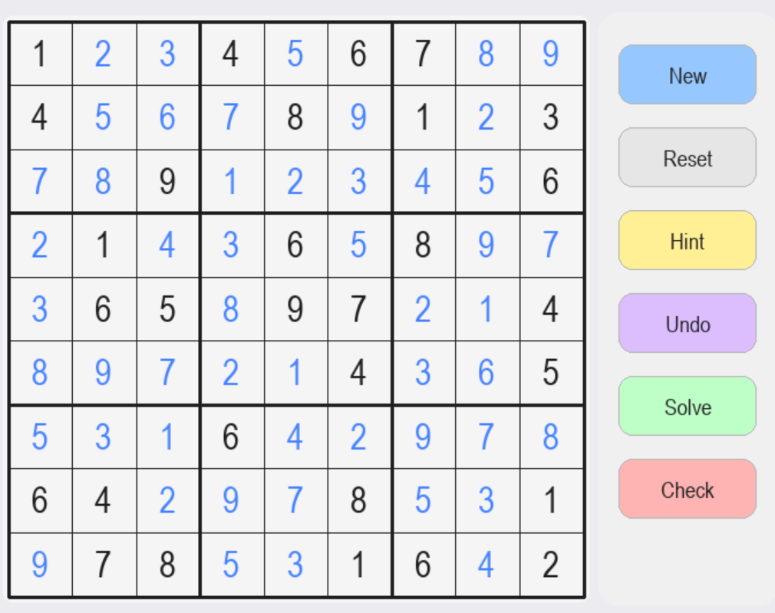
Interface Design
1
Simple, clean layout for easy interaction.
Color coding: Black for default numbers, Blue for user entries.
Buttons for Check, Solve,Undo, Hint, Reset and New.
Optimized 700×650 window
for compact viewing.
2
3
4

Slide 9
Conflict Detection Feature
1
2
3
4
Real-time validation of user entries.
If a number violates Sudoku rules, it highlights temporarily (red).
Encourages learning through self-correction rather than penalties.
A 'Conflict Counter' tracks incorrect placements.

Slide 10
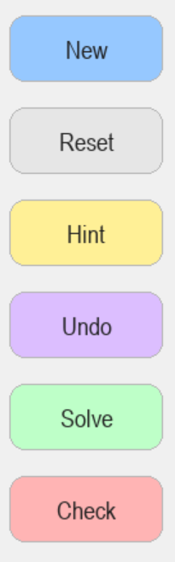
Gameplay Features
1
Starts a new random Sudoku puzzle
2
Reset Option: Restarts the game instantly.
3
Hint Button: Reveals a correct number.
4
Undo Button: Reverts the last move.
5
Solve: Automatically completes the puzzle using the solving algorithm
6
Check Button: Validates the current board state.

Slide 11
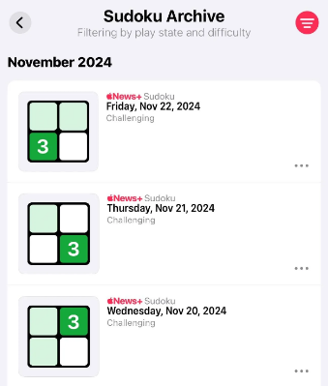
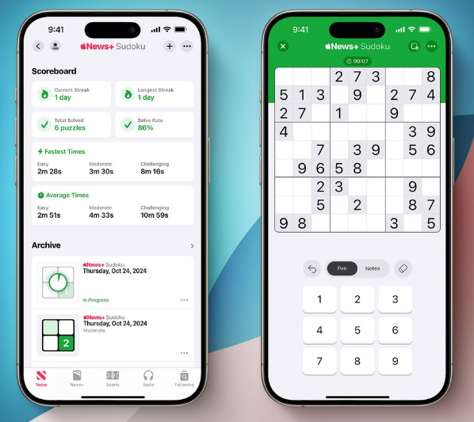


Future Enhancements
1
2
3
4
Add timer and leaderboard system.
Difficulty levels (Easy, Medium, Hard).
Save/Load progress feature.
Mobile-responsive version using Kivy or WebApp integration.

Slide 12
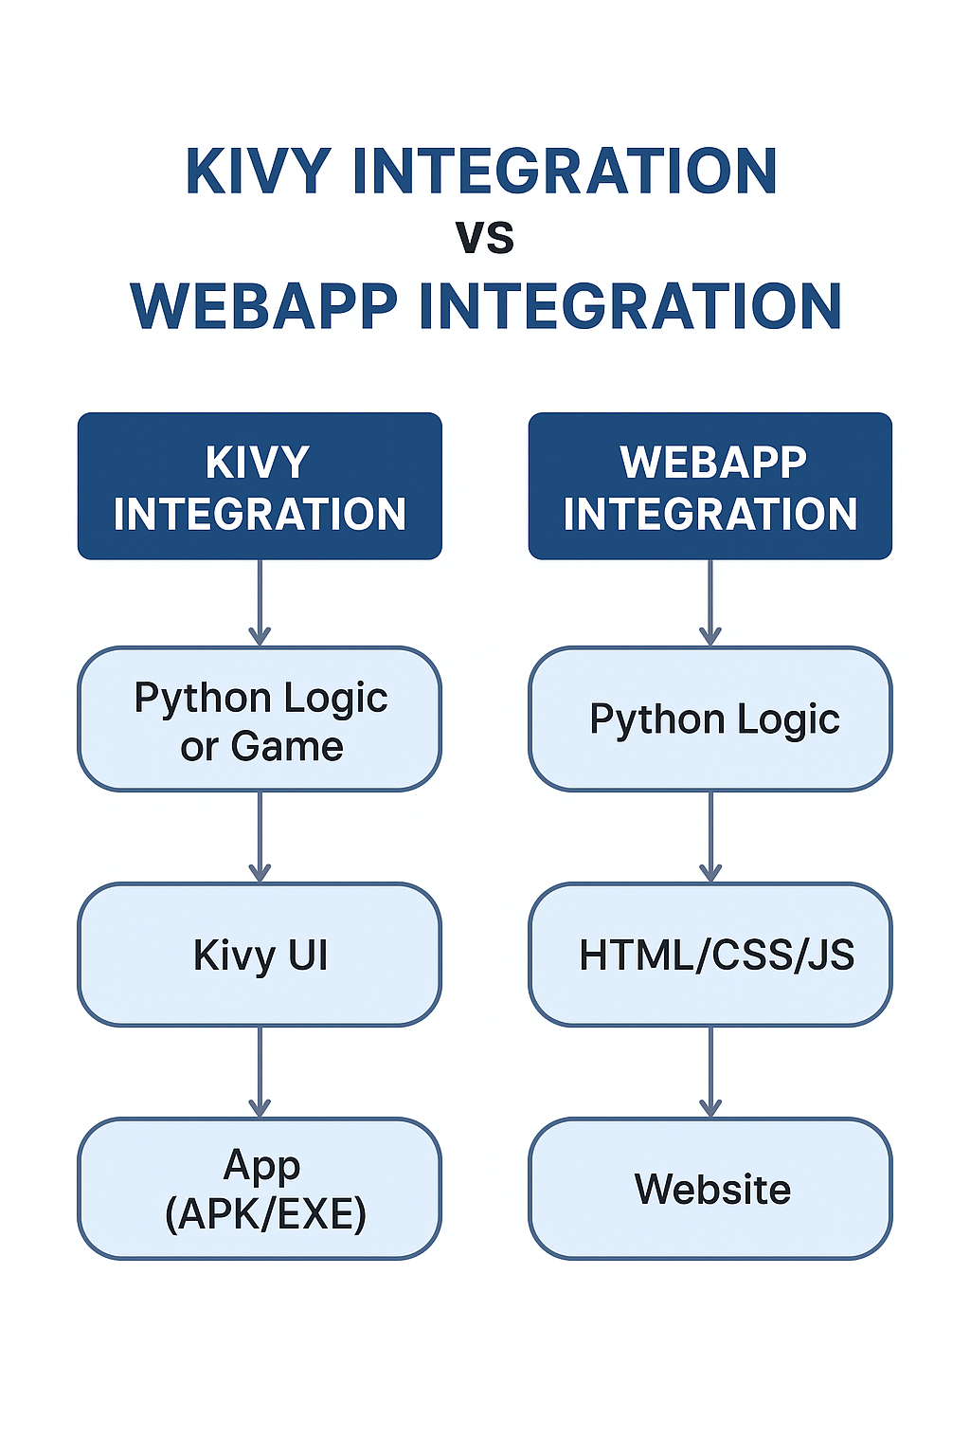

Slide 13
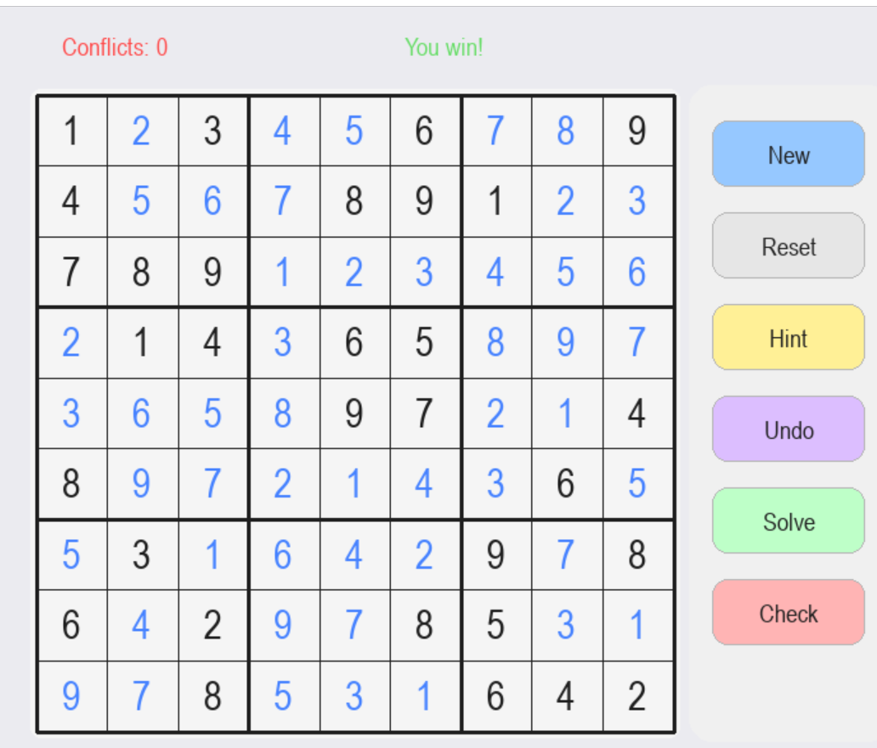
Conclusion
1
This project demonstrates the fusion of logic, design, and interactivity.
It enhances problem-solving skills through an engaging game experience.
Developed with creativity and precision using Python & Pygame.
2
3

Slide 14
Thank you.
Any question?

